Slide 1

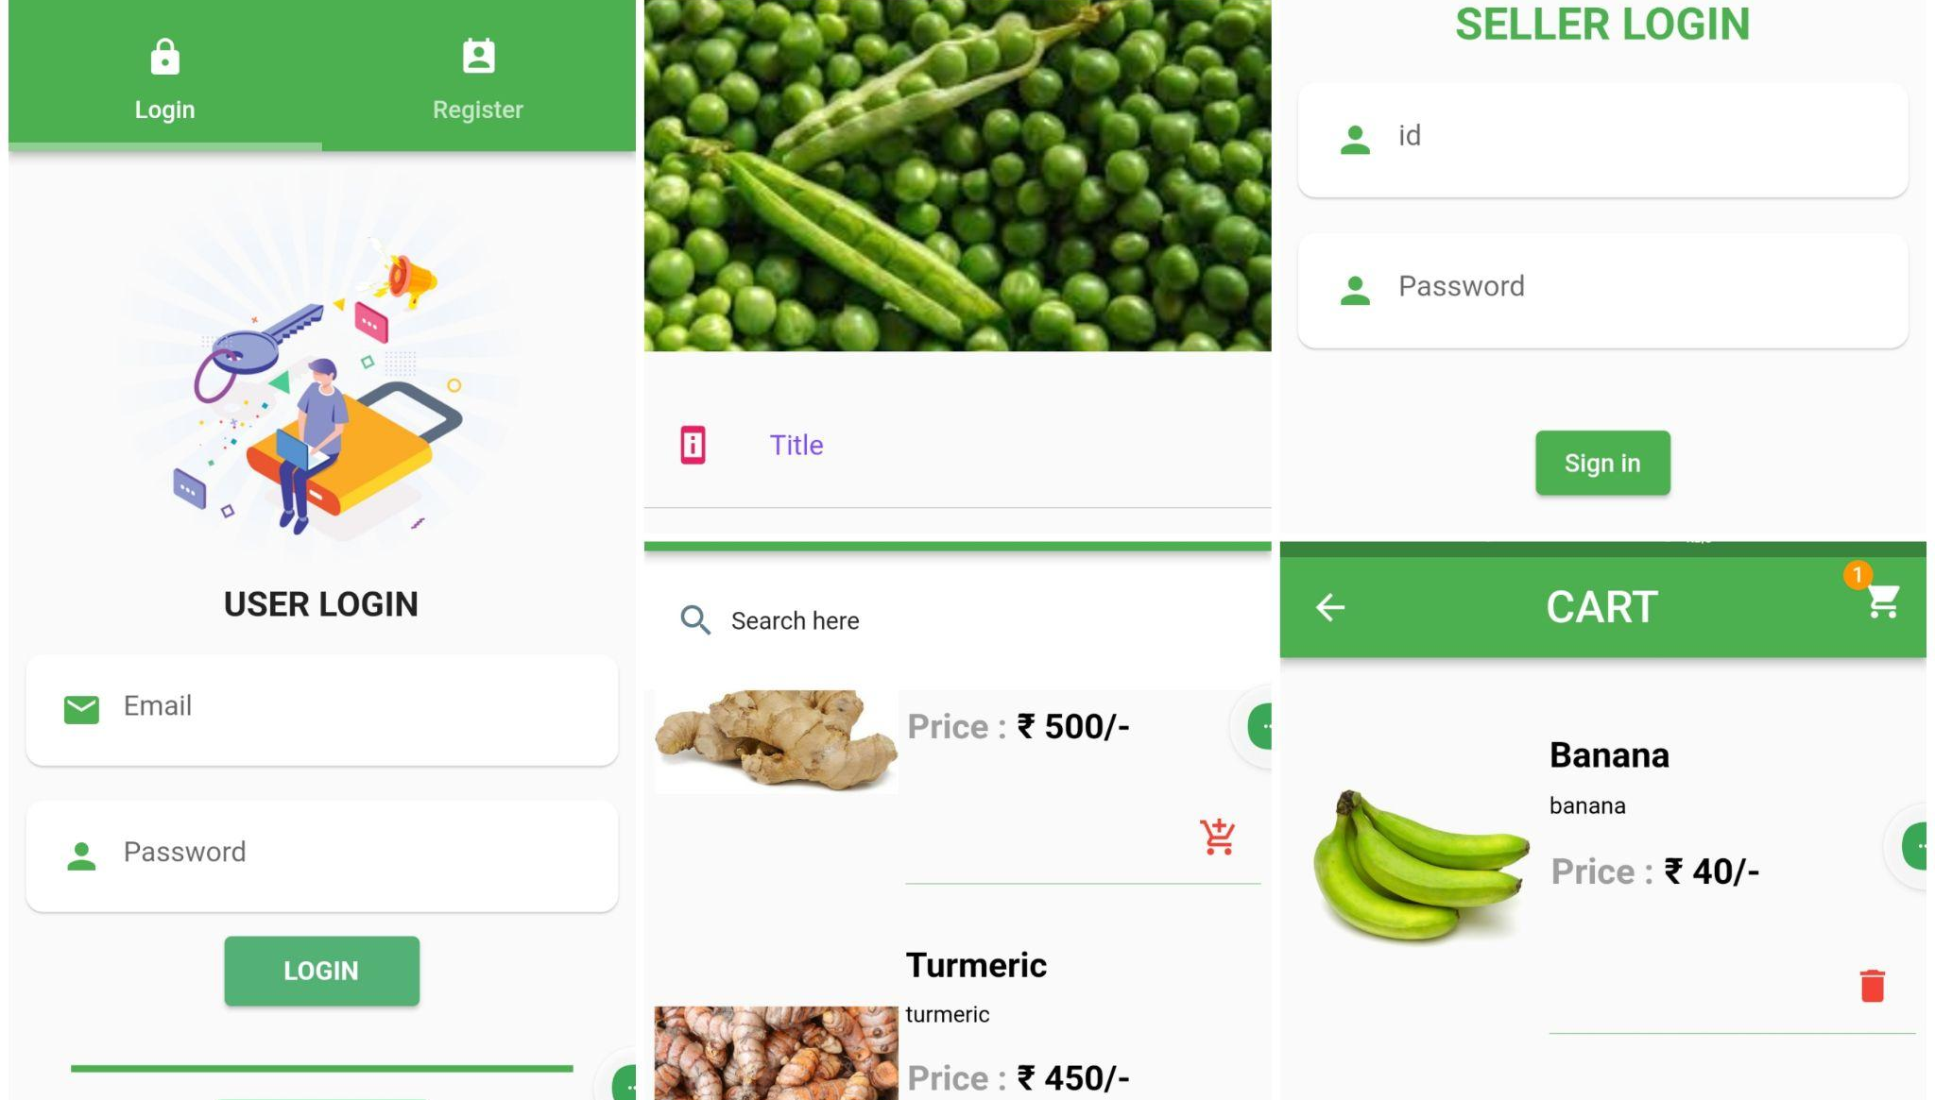


Rural Reach
Aslah
Fazeel Anwar
Mohammed Roshan
Rohith CM

Slide 2
Outline
The Problem
The solution
Implementation
Design

Slide 3
The Problem

Slide 4
PROBLEM STATEMENT
Farmers face challenges to find market.
Limited access to fresh and healthy organic produce to customers.
Loss of revenue for farmers
Exploitation from the middlemen
Raise in the price of produce.
Lack of publicity

Slide 5
REQUIREMENTS
Provides a platform for farmers to sell their produce
Provides a platform for customers to purchase the products.
Provide direct market access to farmers
Access to Fresh and Organic Produce

Slide 6
The Solution

Slide 7
Buyer
Functionalities
User Authentication
Set up Profile
Add to Cart
Add Alternate Addresses
Checkout
Search and Browse Products
Order History

Slide 8
Seller
Functionalities
Seller Login
Add Products
View Orders
Order Management

Slide 9
IMPLEMENTATION

Slide 10
Front End Development
Flutter 3.0.1(dart 3)
Android Studio 4.2
Visual Studio 1.79

Slide 11
PLUGINS
cupertino_icons: ^1.0.2
cloud_firestore: ^4.8.0
firebase_auth: ^4.6.2
shared_preferences: ^2.1.2
fluttertoast: ^8.2.2
image_picker: ^0.8.7+5
firebase_core: ^2.13.1

Slide 12
Cond..
firebase_storage: ^11.2.2
flutter_staggered_grid_view: ^0.6.2
provider: ^6.0.5
path_provider: ^2.0.15
image: ^4.0.17
intl: ^0.18.1
url_launcher: ^6.0.0

Slide 13
DESIGN

Slide 14
Technology Used
-Front end
Flutter
Open-Source dart based framework
Cross Platform Packaging and vast community support
Rich libraries and associated packages
.

Slide 15
Technology Used
-Back end
Firebase
Easy integration with flutter
Firebase Authentication
Firestore database
Storage

Slide 16
User Interface
User Registration
User Login
Home Page
Dashboard
Cart Page
Product Details
My Orders
Seller Login
Add New Item
Orders

Slide 17
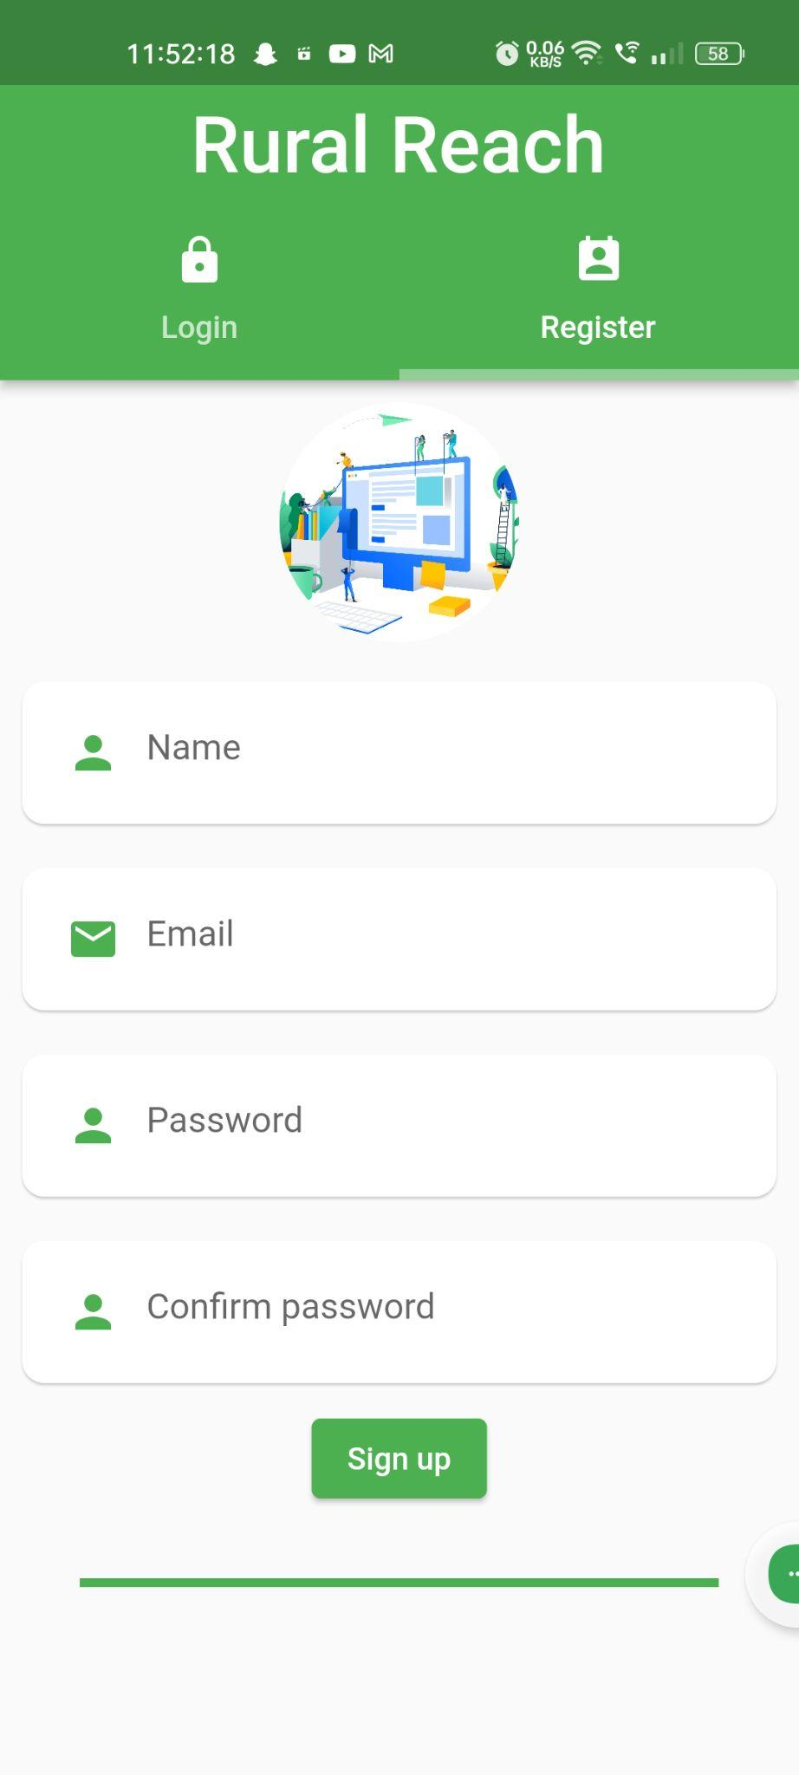
Enables new users to register themselves
USER REGISTRATION

Slide 18
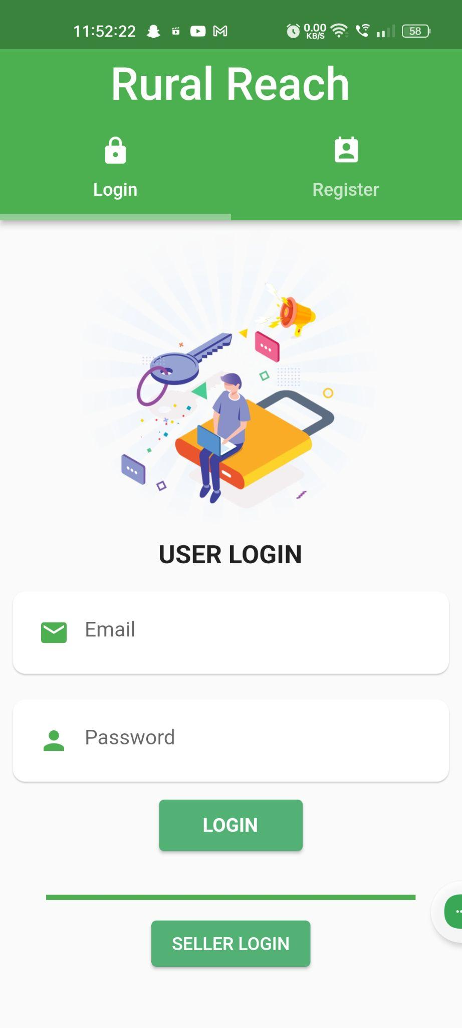
USER LOGIN

Slide 19
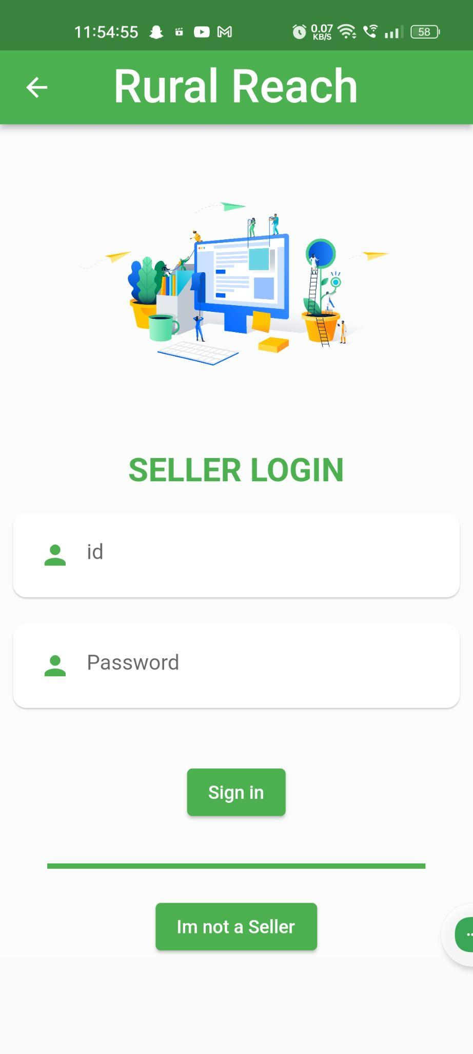
SELLER LOGIN

Slide 20
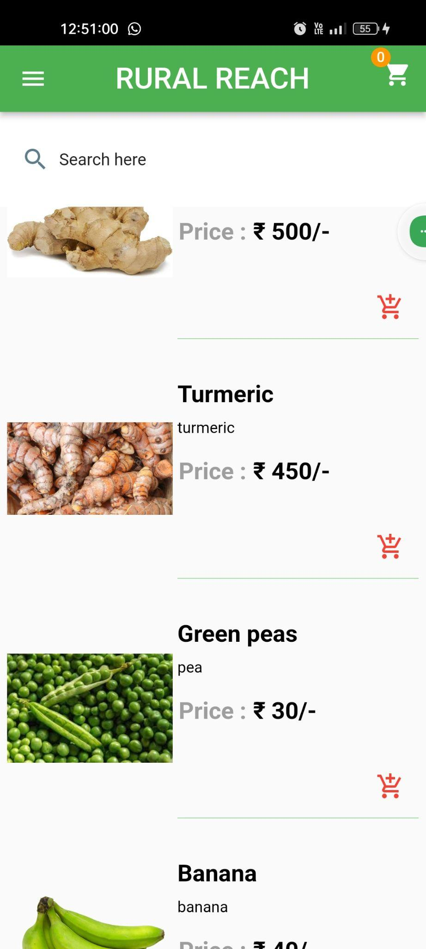
HOME PAGE

Slide 21
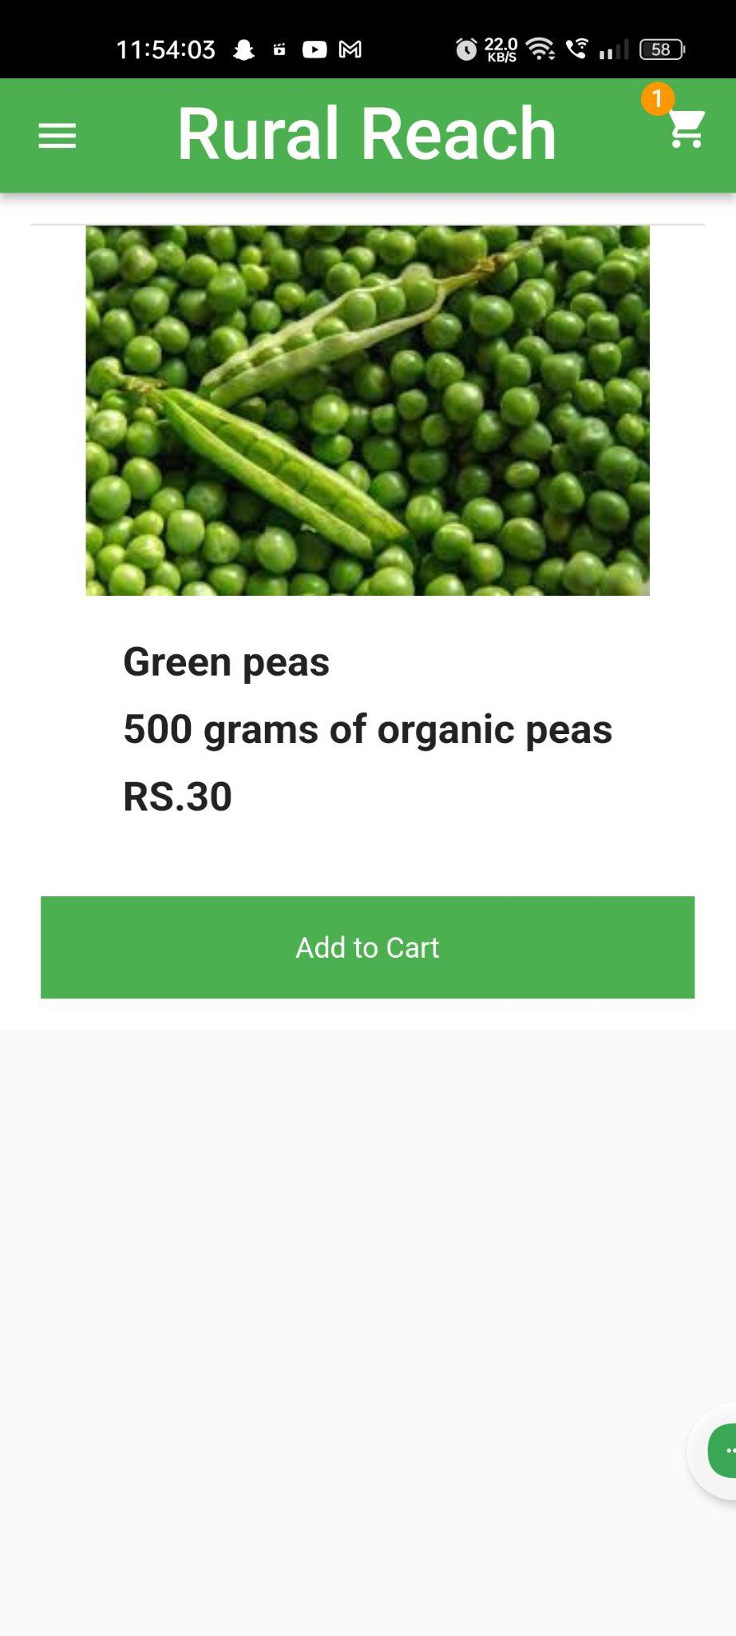
PRODUCT DETAILS

Slide 22
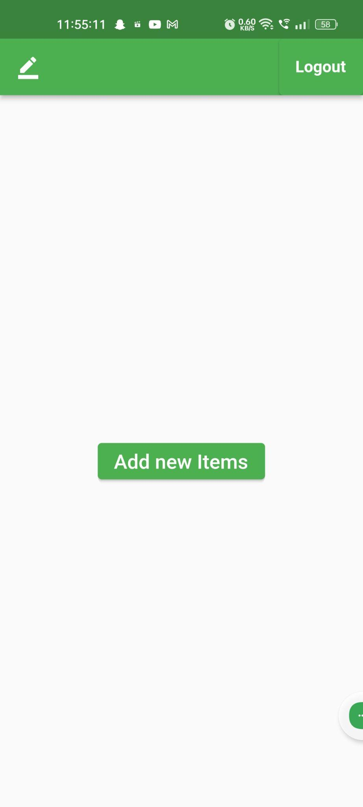
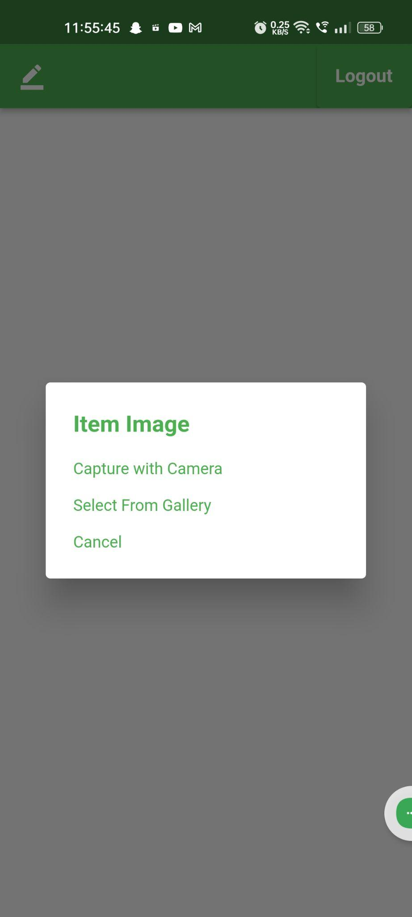
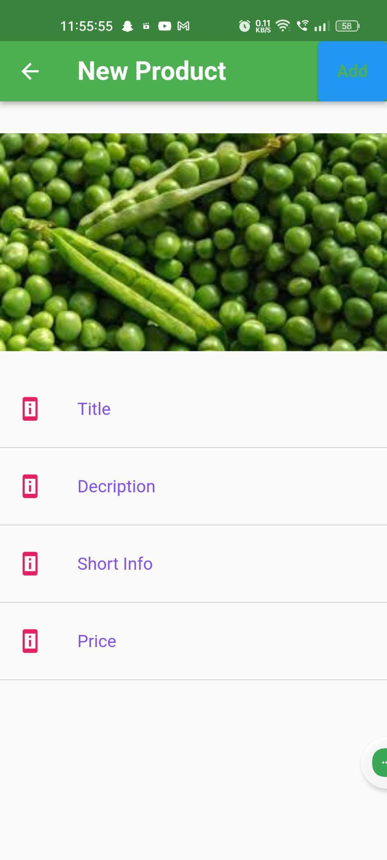
Add new item for selling Upload product’s image Add product description

Slide 23
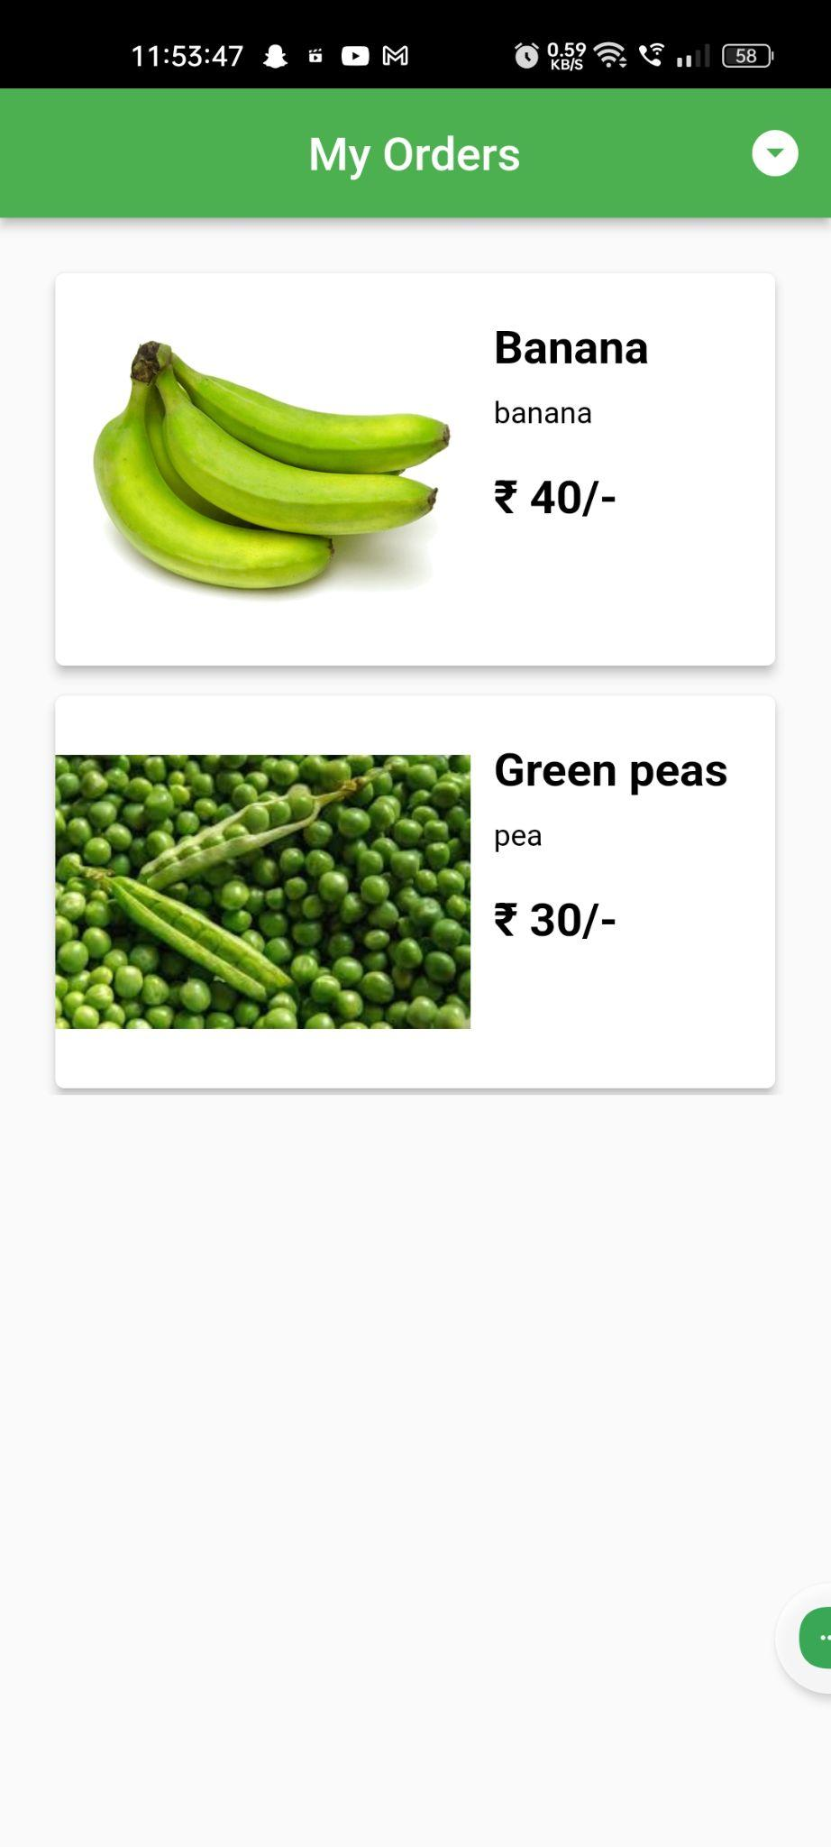
My orders

Slide 24
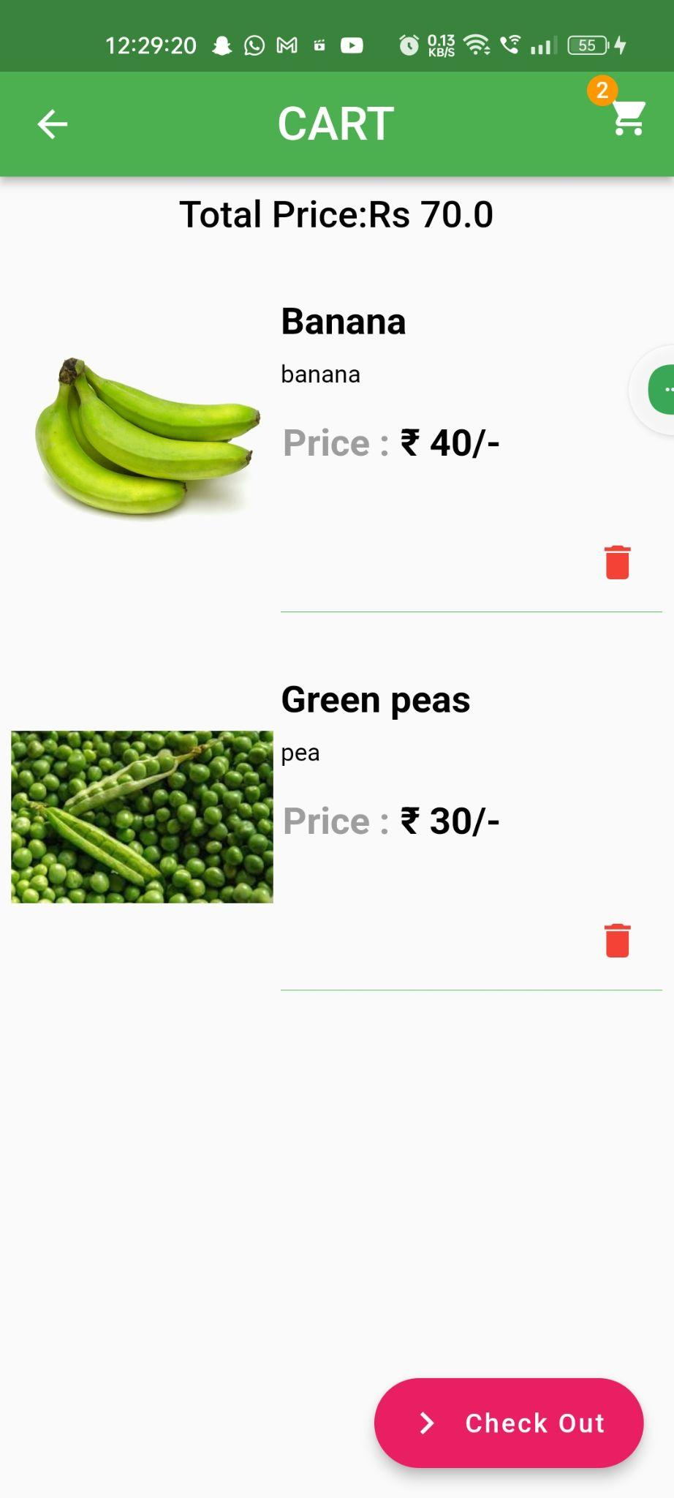
CART

Slide 25
Project Planning

Slide 26
Timeline
MARCH
MARCH
APR-MAY
APR-MAY
MAY_JUN
FUTURE
FUTURE
Requirements gathering
Requirement
finalisation
Wireframes
Review
Prototype
User testing
Deploy

Slide 27
Next Steps

Slide 28
What next?
Inclusion of Household Industries
Collaborations with Local Service Providers
Farmer-to-Restaurant Direct Supply
Integration of Sustainable Packaging

Slide 29
THANK YOU

